Slide 1
ENGR 216 – Spring 2019
Class 04
Descriptive Statistics

Slide 2
Learning Objectives
Know basic statistics describing location and spread of a data set/distribution
How to use Python functions for basic descriptive statistics
An introduction to the Normal Distribution
Understanding how to do the equivalent Z-table calculations in Python
Given a set of population normal-distribution parameters, how to determine the probability of a given range of outcomes
Use z-table calculations to compute a confidence interval on the mean with a specified degree of confidence given the population standard deviation and test data.

Slide 3
Foundations of Statistics
Descriptive Statistics
Summarizes or without attempting to infer conclusions
Inferential Statistics
Statistical generalizations made about the data.
Population – data set contains ALL members or events.
Sample – a subset of a given population.
May be used to predict future outcomes
Measures of Central Tendency
Mean, Median, Mode
Measures of Variation (Spread)
Max / Min (Range), Variance, Standard Deviation

Slide 4
Python descriptive statistics
Python has as functions the standard descriptive statistics in the statistics module. data is the set of real-valued data for which you want to calculate the statistic.
mean(data)
median(data)
mode(data)
variance(data)
stdev(data)
Min and max are standard functions (you don’t need to import statistics)
min(data)
max(data)

Slide 5
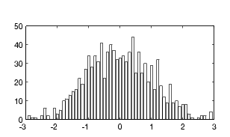
Looking at data - Histograms
Histograms illustrate how values are distributed within a given range (which includes the min and max values).
First you must subdivide the range of values into equally spaced intervals called “bins” (e.g. (max-min)/ # of bins as an estimate).
Once the intervals have been determined, the values found in each respective range must be accounted for.
Represent the information in a graphical form plotting the intervals (bins) on the x axis and the frequency of values in each interval on the y axis.

Slide 6
Frequency Distribution Guidelines
AS A GENERAL RULE, use no less than 6 and no more than 15 classes.
The square root of n, where n is the number of data points, provides an approximate number of classes to consider.
Select classes that will accommodate all of the data points
Make sure that each data point fits into only one class
Whenever possible, make the class intervals equal length.

Slide 7
Bins categorize (group data) and are spread out
Given [ 1 2 2 3 3 4 5 5 5 5 7 7 8 9 9]
How many (frequency) of the data can be categorized in each bin?
The mean is the theoretical center value (average)
(Central tendency also results in mode and median also being at the center)
5
5
5
5
2
2
3
3
4
8
8
Frequency of values in bins - counts
9
9
1
7
1-2 3-4 5-6 7-8 9-10
So, how far is each data point from the theoretical center that describes my data set?
Bins categorizing data - units
theoretical center

Slide 8
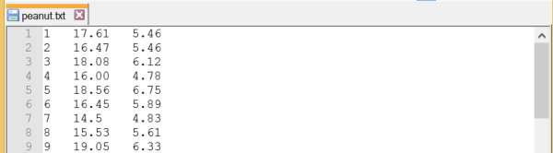
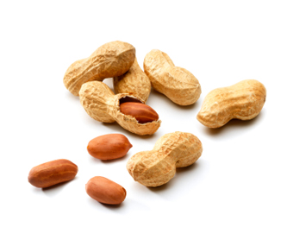
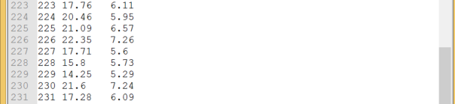
Consider the Following set of Data
Characterizing batches of peanuts coming from farms
Columns of data represent “Sample Number”, “Major Diameter (mm)”,
and “Minor Diameter (mm)”
Image source: http://www.scientificamerican.com/blog/post.cfm?id=peanut-allergic-kids-helped-by-dese-2009-02-20

Slide 9
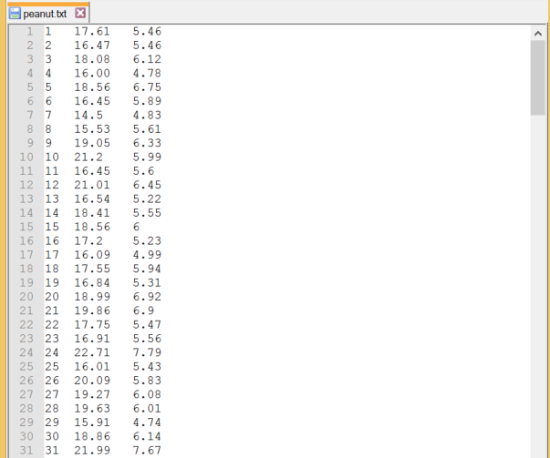
Categorize the Major Diameter data into ranges of measured values
N = 231

Slide 10
Python code to count frequency in bins
import csv import numpy as np with open('c:\work\peanut.csv') as csv_file: csv_reader = csv.reader(csv_file, delimiter = ',') line_count = 0 sampleNo = [] major = [] # major axis lengths of the peanuts minor = [] # minor axis lengths of the peanuts for row in csv_reader: if line_count == 0: # this is the header line_count += 1 else: sampleNo.append(row[0]) major.append(float(row[1])) minor.append(float(row[2])) # now make a histogram npMajor = np.asarray(major) histCount, bin_edges = np.histogram(npMajor, bins=[10,12,14,16,18,20,22,24,26]) print(histCount) print(bin_edges)

Slide 11
Major Diameter of a Peanut Crop
Mean = 18.13
Median = 18.18
Mode = 18.19
Variance = 4.07
Std Dev = 2.02
Minimum = 11.23
Maximum = 25.03
What do you find interesting about the first three descriptive statistics?
What does this tell us about our data?

Slide 12
Making a Histogram

Slide 13
Python code to plot a histogram
import csv import matplotlib.pyplot as plt import numpy as np with open('c:\work\peanut.csv') as csv_file: csv_reader = csv.reader(csv_file, delimiter = ',') line_count = 0 sampleNo = [] major = [] # major axis lengths of the peanuts minor = [] # minor axis lengths of the peanuts for row in csv_reader: if line_count == 0: # this is the header line_count += 1 else: sampleNo.append(row[0]) major.append(float(row[1])) minor.append(float(row[2])) n, bins, patches = plt.hist(x=npMajor, bins=[10,12,14,16,18,20,22,24,26]) plt.xlabel('Major Diameter (mm)') plt.ylabel('Frequency') plt.title('Peanut Sample') plt.show()

Slide 14
Normal Distribution of Data – Central Tendency

Slide 15
Team Exercise 5.1.1 - Probability
Histograms can be used to determine the probability of a value falling into a given classification.
Given the histogram illustrating the sample of 231 peanuts, what is the probability of sampling another peanut with a major diameter in the range of 20-22 mm?

Slide 16
Team Exercise 5.1.1 - Probability
Histograms can be used to used to determine the probability of a value falling into a given classification
This area represents the probability of the major diameter of a peanut being between 20.00 and 21.99 mm.
33
With enough points we can construct a histogram and identify what percentage of the total points fall within a specific category (or categories).

Slide 17
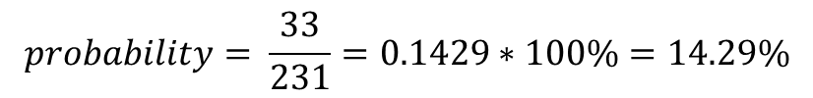
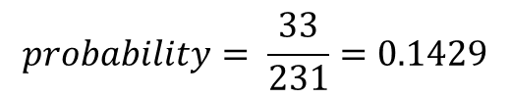
Probability
33
$$probability= \frac{33}{231}=0.1429$$
Sometimes it’s helpful to express probability as a percentage
$$probability= \frac{33}{231}=0.1429∗100\%=14.29\%$$

Slide 18
Team Exercise 5.1.2
What is the probability of a peanut having a major diameter between 16.00 and 19.99 mm?
N = 231

Slide 19
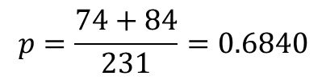
Team Exercise 5.1.2
What is the probability of a peanut having a major diameter between 16.00 and 19.99 mm?
$$p=\frac{74+84}{231}=0.6840$$
or p = 68.40%
N = 231

Slide 20
Team Exercise 5.1.3 Relative Frequency Distribution
What is the probability of a peanut having a major diameter between 16.00 and 19.99 mm?
0.364
0.320
0.134
0.143
0.009
0.022
0.004
0.004

Slide 21

Team Exercise 5.1.3 Relative Frequency Distribution
What is the probability of a peanut having a major diameter between 16.00 and 19.99 mm?
0.364
$$\frac{74}{231}$$
0.320
0.134
0.143
0.009
0.022
0.004
0.004
$$p=\left(0.3204+0.3636\right)∗100\%=68.40\%$$

Slide 22
Exercise 5.1.3 Relative Frequency Distribution
Now given the probability of a peanut having a major diameter between 16.00 and 19.99 mm -
$$p=\left(0.3204+0.3636\right)∗100\%=68.40\%$$
What if the question is reversed. In a sample batch of 2000 peanuts, how many would we expect to have a major diameter between 16.00 and 19.99 mm?
2000*0.6840 = 1368

Slide 23
Histogram: Discrete Distribution Approaches Continuous Distribution

Slide 24
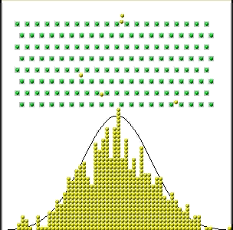
Normal (Bell Shaped) Distribution
How far will the ball fall from where it is dropped into the system of evenly spaced pegs?
The majority of the total number of balls fall near the center, where the ball initially entered the Galton Machine (system).

Slide 25
Simulations of Normal Distribution
Https://www.youtube.com/watch?v=3m4bxse2JEQ
https://www.youtube.com/watch?v=03tx4v0i7MA
https://www.youtube.com/watch?v=6YDHBFVIvIs

Slide 26
Why does this work?
Every time a ball hits a peg, it makes a (quasi) random movement to the right or the left.
It can be shown that the sum of many random values will give you a normal distribution* (technical term: Central Limit theorem)
This is why the normal distribution shows up so much in statistics – we are surrounded by little random errors!
*Certain mathematical conditions have to be met; usually they are. Take a mathematical statistics course if you care to know about them.

Slide 27
Continuous Distributions
Histograms (a frequency distribution) can be approximated by means of a smooth curve commonly called a continuous distribution (probability density function, PDF).
The probability associated with any interval is then related to area under the curve bounded by the interval.
There are many types of continuous distributions, but the most common one is the Normal Distribution.

Slide 28
Normal Distribution
The Normal Distribution is one of the best-known continuous probability distributions. It is also known as the Gaussian distribution, named in honor of Carl Friedrich Gauss (1777-1855), a mathematician who used the distribution extensively to explain data from many physical phenomena.

Slide 29
Normal Distribution: Varying Standard Deviation for the Same Mean Value

Slide 30
Normal Distribution: Varying Mean Value for the Same Standard Deviation

Slide 31
How is this used to compute the probability?

Slide 33
Normal Distribution:
Integration from –infinity to the mean

Slide 34
Normal Distribution:
Integration from 16 to 19.99
Recall the peanut problem: What if we wanted to know the probability of a diameter between 16 mm and 19.99 mm?

Slide 35
Normal Distribution:
Integration is not a trivial task
What shall we do?
We need to integrate to get areas under the curve to get probabilities.
Let’s normalize the distribution using a variable Z
Let’s have someone integrate the normal distribution for varying values of Z and compile a table that is freely available from any number of different sources
Whatever problem we have, we will normalize to the Z variable and simply read the integral results from a table

Slide 36
Standard Normal Distribution
Assuming that a random variable is distributed normally with mean μ and standard deviation σ, the transformation to the standard normal distribution is accomplished as follows:
Where it can be shown that z has a mean equal to 0 and a variance equal to 1.

Slide 37
What is the Z Conversion?
if
, then one can say
and similarly,
etc….

Slide 38
x-scale
μ−3σ
μ−2σ
μ−σ
μ
μ+σ
μ+2σ
μ+3σ
z-scale
-3
-2
-1
0
1
2
3

Slide 39
Since the data for a standard normal curve represent normalized values, that is, we have converted to a standard scale, which we now call z , we can integrate one-time and tabulate the values for any normal distribution
e.g.
0
1
2
3

Slide 40
The standardizing of a particular value of x results in a z value that has a special interpretation, i.e., it represents how many standard deviations above or below the mean the original x value is located.
68.27%
95.45%
x-scale
μ−2σ
μ−σ
μ
μ+σ
μ+2σ
z-scale
-2
-1
0
1
2

Slide 41

How do you get z-values?
In days of old, you would read them off of a table…
“To use the z-table, thou shalt count to 1.96…”
(watch out for killer rabbits)

Slide 42
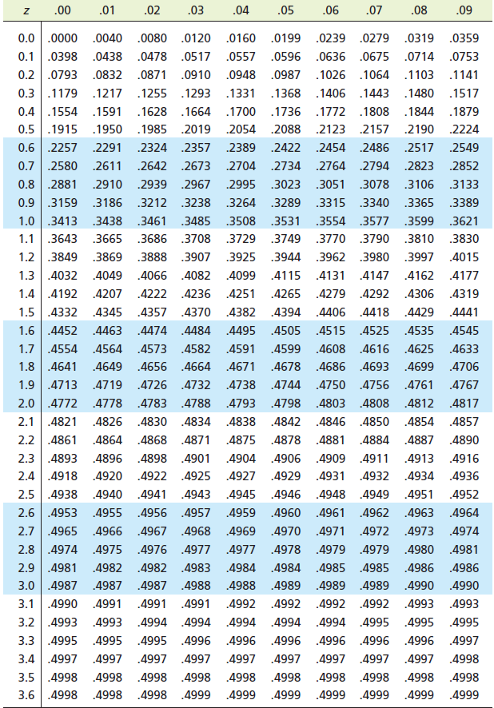
The Standard Normal Integration Table
PDF versions are available on eCampus

Slide 43
How do you read the table?
Since the standard normal distribution is symmetric about the mean value, the values in the table represent numerical integrals (areas under the curve) for values of z starting at the mean value (μ), i.e., when z = 0, to z = 4. You have to add 0.5 to the table value to get the total cumulative probability!
Why only z = 4? After z = 4 the area remains relatively constant (for the stated precision).

Slide 44
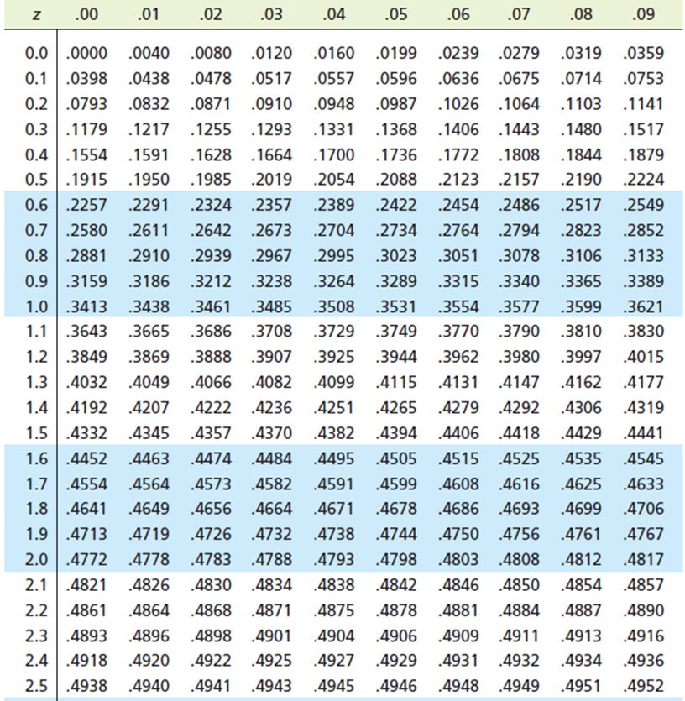
How do you read the table? (continued)
For example, assume you computed a z value of 0.13.
You would go to the table and look up the area under the standard normal distribution to be 0.5517.

Slide 45
Hey, wait I have a computer, why am I reading tables?
z-values are available using the scipy.stats.norm method
This lets us calculate z-values for any probability
from scipy.stats import norm zVal = [0.13] xVal = norm.cdf(zVal) print(xVal)
C:\work\someTests\venv\Scripts\python.exe C:/work/someTests/venv/zValues.py
[0.55171679]
Process finished with exit code 0

Slide 46
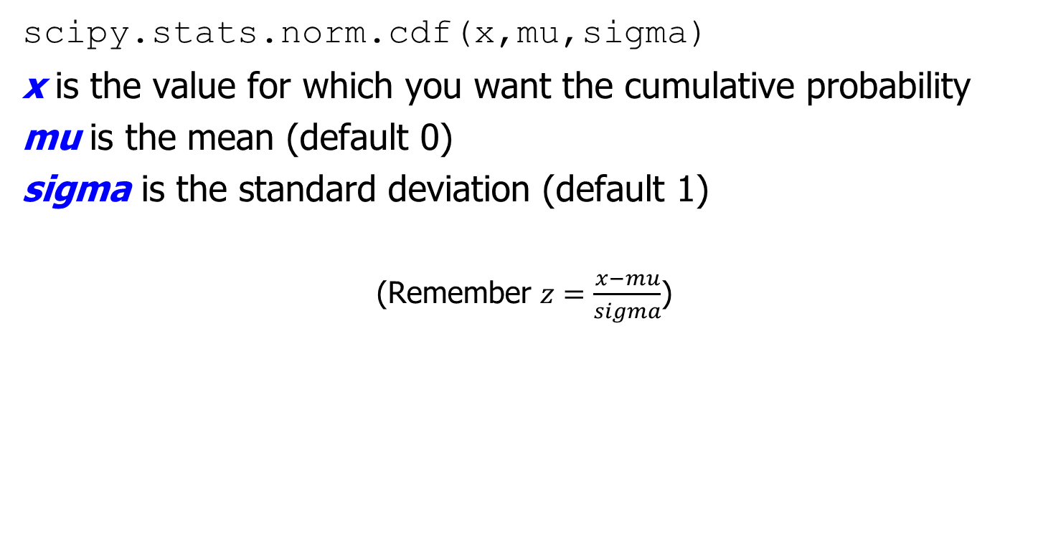
normcdf explained
scipy.stats.norm.cdf(x,mu,sigma)
x is the value for which you want the cumulative probability
mu is the mean (default 0)
sigma is the standard deviation (default 1)
(Remember $z=\frac{x−mu}{sigma}$)

Slide 47
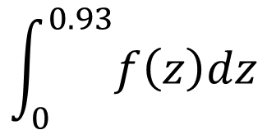
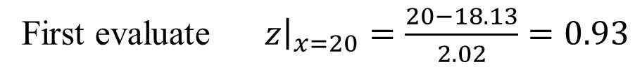
Back to the Peanut Problem
OK how do we use this stuff…….
What is the probability of a peanut having a major diameter of between 20.00 mm and 21.99 mm?
(Recall for this problem that sample μ = 18.13 mm and sample σ = 2.02 mm. We assume here sample values can be used for population values)
First evaluate ${\left.z\right|}_{x=20}=\frac{20−18.13}{2.02}=0.93$
If you look the value of 0.93 up in the table implies that you are really finding:
$$\int_{0}^{0.93}{f\left(z\right)dz}$$

Slide 48
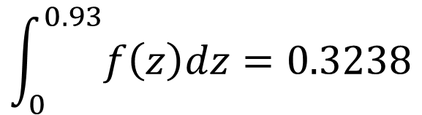
Back to the Peanut Problem
Thus, the area under the distribution function from z = 0 to z = 0.93 is 0.3238. Or, stated mathematically, one would write:
$$\int_{0}^{0.93}{f\left(z\right)dz}=0.3238$$

Slide 49
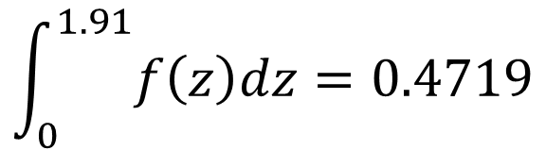
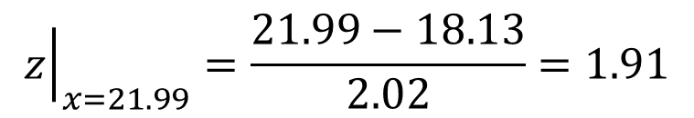
Back to the Peanut Problem
Next, find the area from x = μ to x = 21.99:
$${\left.z\right|}_{x=21.99}=\frac{21.99−18.13}{2.02}=1.91$$
$$\int_{0}^{1.91}{f\left(z\right)dz}=0.4719$$

Slide 50
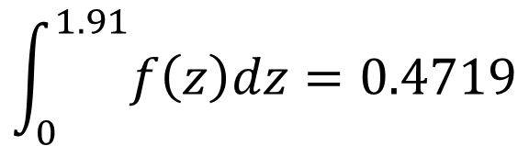
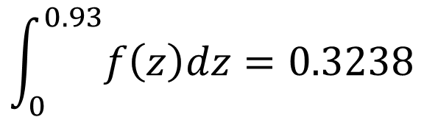
Back to the Peanut Problem (continued)
So, now you have the integrals:
$$\int_{0}^{0.93}{f\left(z\right)dz}=0.3238$$
and
$$\int_{0}^{1.91}{f\left(z\right)dz}=0.4719$$
Since the probability of a peanut diameter falling in the range between 20 mm (z = 0.93) and 21.99 mm (z = 1.91) is represented by the area under the distribution curve between 20 mm and 21.99 mm, what is the next step?

Slide 51
Back to the Peanut Problem (continued)
Simply take the difference between the two areas, such that:
$${area}_{20.00−21.99}=0.4719−0.3238=0.1481$$
Therefore, the probability is 14.81%

Slide 52
Peanuts for Python
In Python we would have
from scipy.stats import norm xVal1 = norm.cdf(21.99,18.13,2.02) print(xVal1) xVal2 = norm.cdf(20,18.13,2.02) print(xVal2) print(xVal1 - xVal2)
C:\work\someTests\venv\Scripts\python.exe C:/work/someTests/venv/zValues.py
0.9719907107777724
0.8227101115489666
0.14928059922880588
Process finished with exit code 0

Slide 53
Hey, wait!
14.93% ~= 14.81% !
Python uses more exact z-values for the integration which are more accurate because it doesn’t round the z values

